Slide 1
Photomicrographs of Plant foods
Tomato
Permission to reproduce original photomicrographs used to make this collection may be obtained from
Dr. David O. Norris at
david.norris@colorado.edu

Slide 2
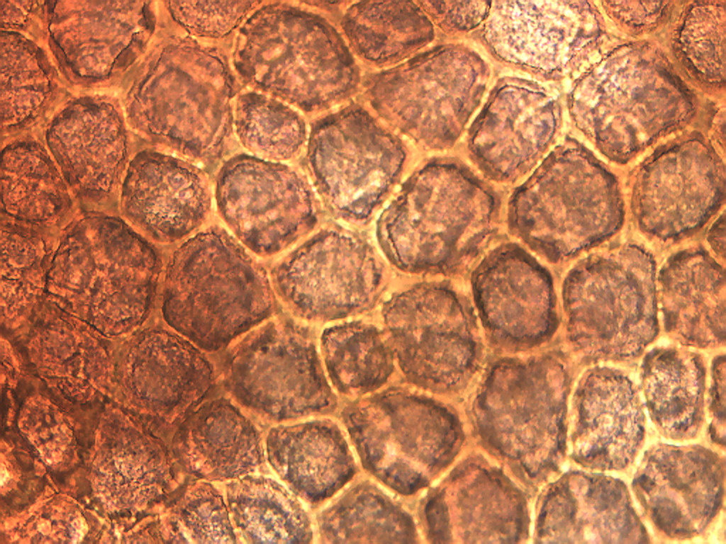
Notes:
489. Solanum lycopersicum L. Tomato. Epidermal cells of tomato skin, stained with safranin, 25X.

Slide 3
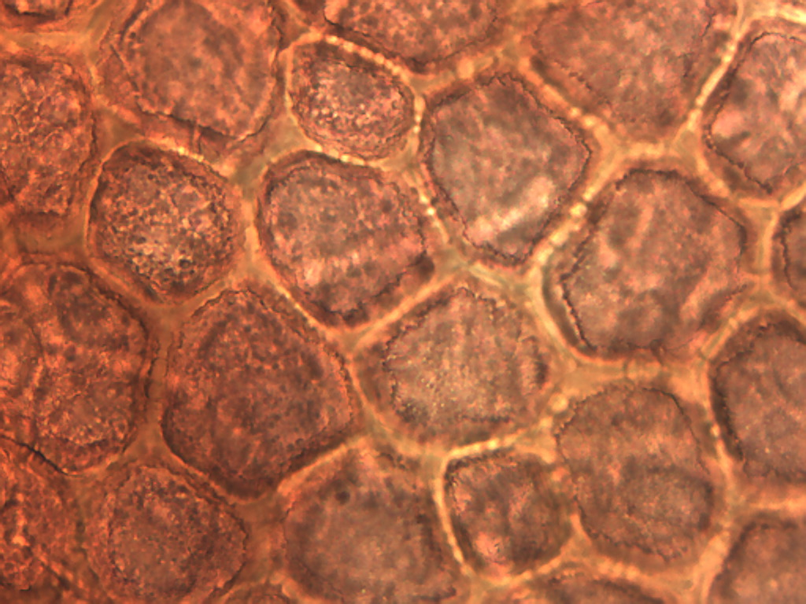
Notes:
490. Tomato. Epidermal cells of tomato skin, stained with safranin, 40X.

Slide 4
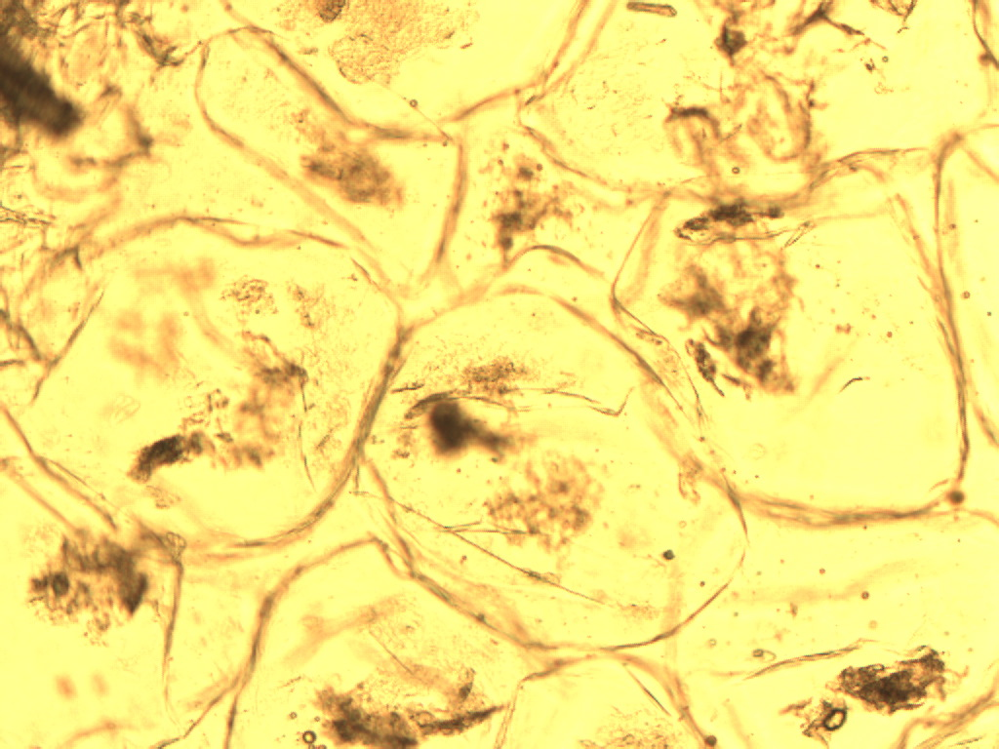
Notes:
491. Tomato. Pulp parenchymal cells from a homemade tomato-carrot soup, 10X.

Slide 5
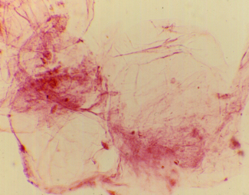
Notes:
492. Tomato. Parenchymal pulp cells from fresh tomato, stained with safranin, 10X.

